Slide 1


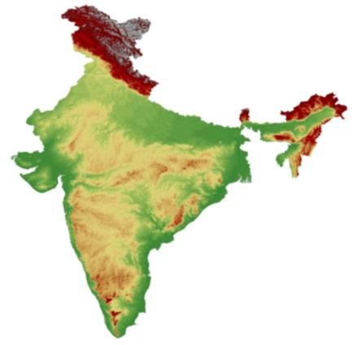
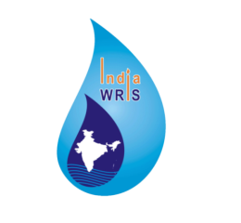
Project : India - WRIS Web GIS
A Joint Project of CWC and ISRO
Generation of Database and Implementation of
Web Enabled Water Resources Information System in the Country
BY
ALOK PAUL KALSI
Deputy Director (RS)
CWC, New Delhi
www.india-wris.nrsc.gov.in

Slide 2

Water Resources Scenario - INDIA
2.45% of World’s Land Area
4% of World’s Renewable Water Resources
17% of World’s Population
Water Availability – 1545 cum/person/year
Scarcity - 1000
Total Precipitation (rainfall + snowfall)
4000 BCM
Total water availability
1869 BCM
Total utilizable water resources
1123 BCM (28%)
Surface water
690 BCM
Ground Water
433 BCM
Current utilization
of SW
450 BCM ( 65% )
Current utilization
Of GW
231 BCM (58%)
Presently meets the demand but is Inadequate for future demand

Slide 3
Spatial Variation of Rainfall in INDIA
75% During Monsoon
No of rainy Days – 5 to 150
Rainfall in mm
Average | 1,170
Max. | 11,000 | Mawsynram Meghalaya
Min. | 100 | Western Rajasthan
3

Slide 4
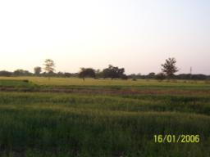
Major Achievements in Water Sector
Total Large Dams- 5426
Total Storage – 304.3 BCM
Net Sown Area – 142 M ha
Total Irrigation Potential – 140 M ha
Irrigation Potential Developed – 112.3 M ha (80%)
Highest Area Under Irrigation in the World 62 M ha
Food Grain Production – 250 Million Tonne
Total Identified HE Potential – 1,48,701 MW
Total Installed Capacity – 39,623 MW

Slide 5
Data for water Resource Planning
General Planning – Administrative information, Terrain Data
Structure Design (Dam & canal, Power House) – Geology, Soil, Material, Seismic Zones
Water & Irrigation Planning – Meteorological data, Hydrology data (River flow, Sediment, Water Quality)
Reservoir Planning – Demographic data, Contour data, Different kind of land data including Forest, Ecological data, Economic data
Canal and Command - Land data, Demographic data, Ground water, Agriculture data, Soil data, Economic data

Slide 6
National Water Policy
Water resources development and management will have to be planned for a hydrological unit.
Water related data, like rainfall, snowfall, geo-morphological, climatic, geological, surface water, ground water, water quality, ecological, water extraction and use, irrigated area should be integrated with well defined procedures and formats to ensure online updation and transfer of data to facilitate development of database for informed decision making in the management of water resources
National Water Mission For Climate Change
Comprehensive water data base in public domain and assessment of the impact of climate change on water resources

Slide 7
Provision in Inter-State Water Dispute Act-1956
Maintenance of Data Bank and Information
The Central Government shall maintain a data bank and information system at the national level for each river basin which shall include data regarding water resources, land, agriculture, and matters relating thereto, as the Central Government may prescribe from time to time. The State Government shall supply the data to the Central Government or to an agency appointed by the Central Government for the purpose, as and when required.

Slide 8
Background
India-WRIS - Background
In the 4th meeting of NNRMS - Standing Committee, Water Resources (SC-W) on 15th Feb.,2006 Secretary, Water Resources (Dr Harinarayan) stressed the need to generate total information on all aspects of water resources at national level at one place in an integrated fashion for use across Ministry of Water Resources (MoWR) offices and also for other stake holders.
After several round of discussions for two years the proposal was finalised
MOU signed in December 2008
Rs 78.32 Crore
Project Duration - January 2009 – December 2012
Project Extended up to December 2015

Slide 9
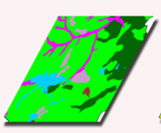

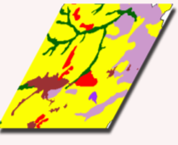
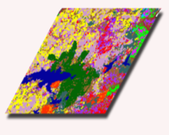
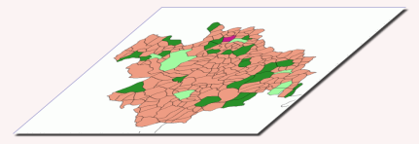
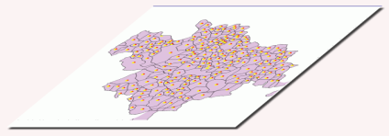
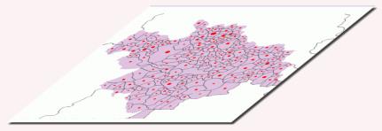
SCOPE OF PROJECT
Based on the requirements and data availability, the project scope has 5 major groups having 30 spatial layers with more than 108 sub layers of 5-50 years data and Basin-Wise report generation.
All the new database creation under India-WRIS is proposed at 1:50,000 scale.
The project envisages WGS-84 datum and LCC projection for entire country mosaic data.

Slide 10
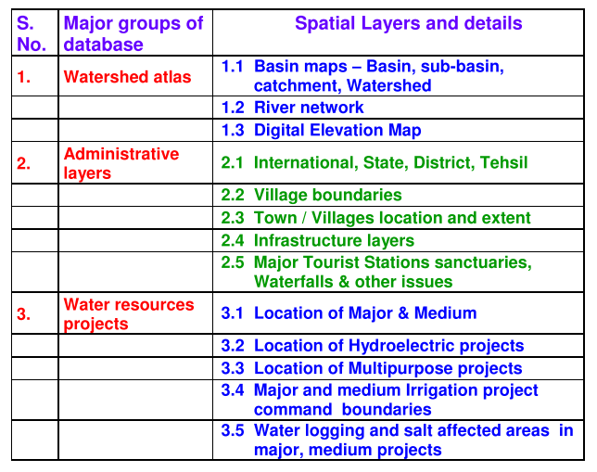
India-WRIS - Database

Slide 11
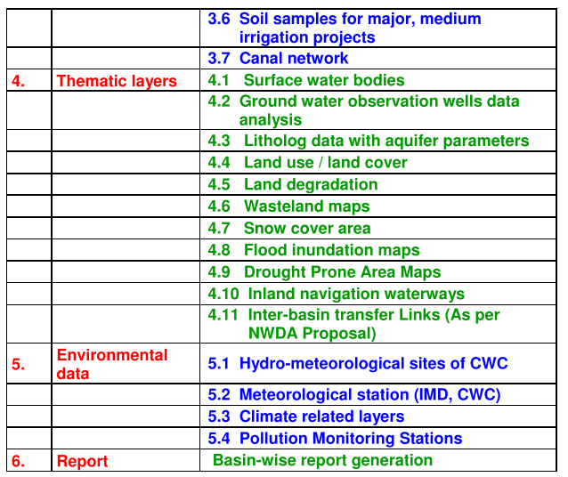
India-WRIS - Database

Slide 12
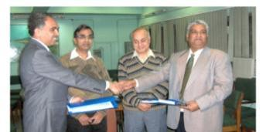
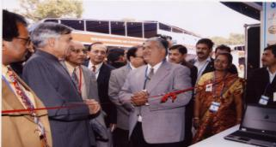
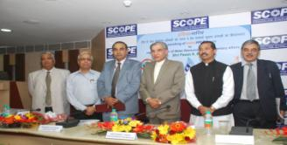
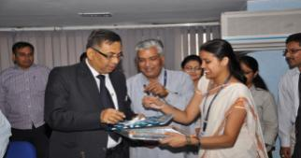
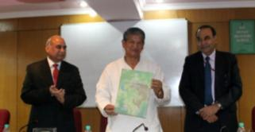
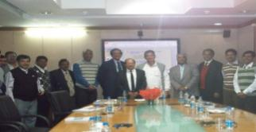
Milestones Achieved
MOU Signing – Dec. 3, 2008
Website Launch- Dec. 10, 2009
Version 1.0 Launch- Dec 7, 2010
Version 2.0 Launch – March 22, 2012
River Basin Atlas Release – Nov 1, 2012
Version 3.0 Launch Dec. 4, 2012

Slide 13
Major Digitization Work
Source: Merged Product of Cartosat – I & LISS-IV data & SOI
Scale: 1:50K
Basin/Sub-Basin/Watershed – 27/101/4566
River – 36 lakh km
Water bodies (upto 0.5 ha) – 8 lakh
Road Network (Upto village) – 27.0 lakh km
Settlement Location & Extent – 9 lakh/8.9 lakh ( 77,798 sq km)
Canal network – 3.20 lakh km

Slide 14
PRESENT STATUS
Total 4 version uploaded
Present version has 95 GIS layer
Scale is 1:2,50,000
CWC telemetry network connected and real time information available
CWC H.O. un-classified data uploaded which can be freely downloaded
CGWB 10 years data in the form of graphs uploaded
River Basin Atlas of India
Version on 1:50 K, Basin reports & Watershed Atlas will be shortly launched

Slide 15
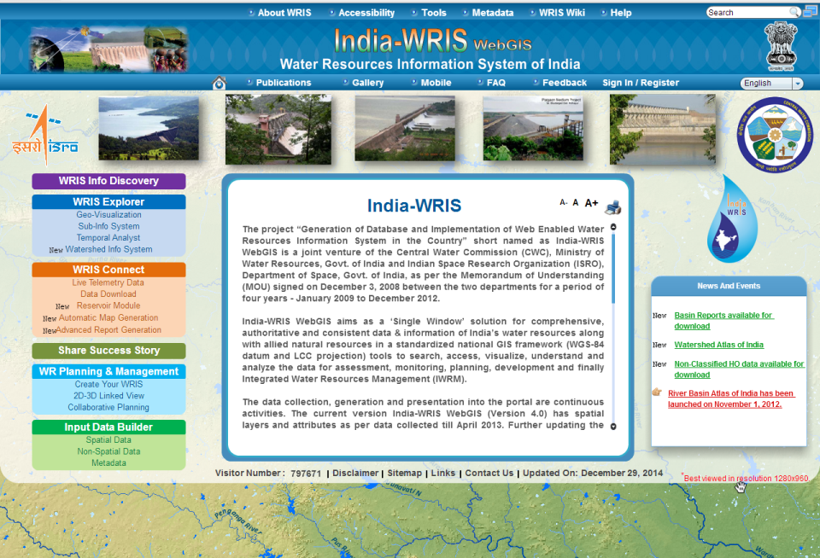
Front GUI of information system

Slide 16
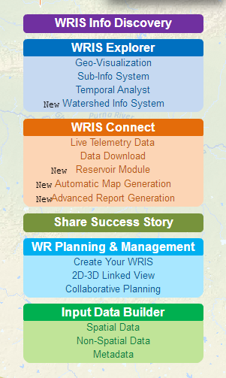
Modules of the Information System
WRIS Info Discovery & Data Catalog module provides the details about the layers and data availability along with metadata information based on area of interest
WRIS-Explorer module has Interactive system for Geo-visualization, exploring various sub-info systems and analyzing the temporal data
WRIS Connect contains module: Query interface module which allows users to query spatial and non-spatial data, Report Generation module to generate reports based on hydrology or administrative unit and Data Download module
Share Success Story module to share/view various water related success stories over the globe
Water Resources Planning It allow user to create your maps, 2D to 3D visualization with Google earth and sharing information among users in participatory mode like text file, maps, videos etc
Input Data Builder module allows privileged users to add or update the spatial, non-spatial data and metadata information

Slide 17
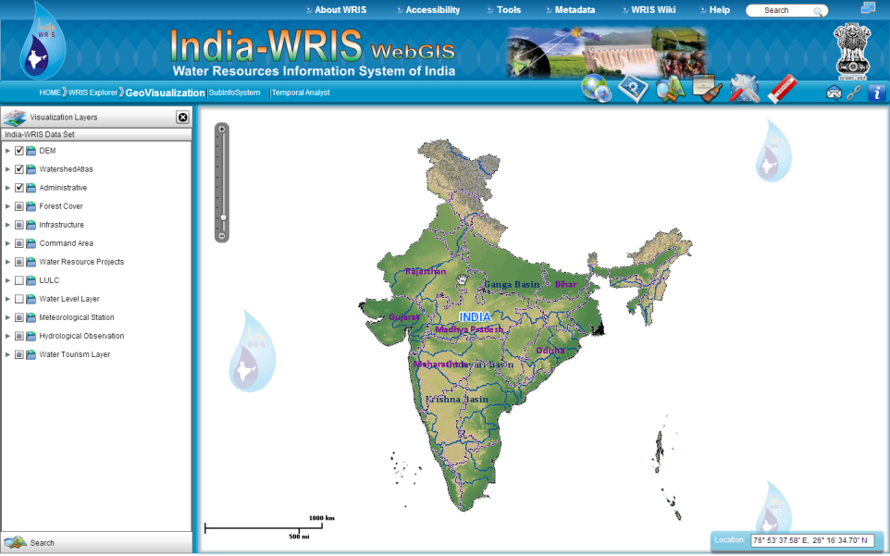
INDIA-WRIS : Geo-visualization

Slide 18
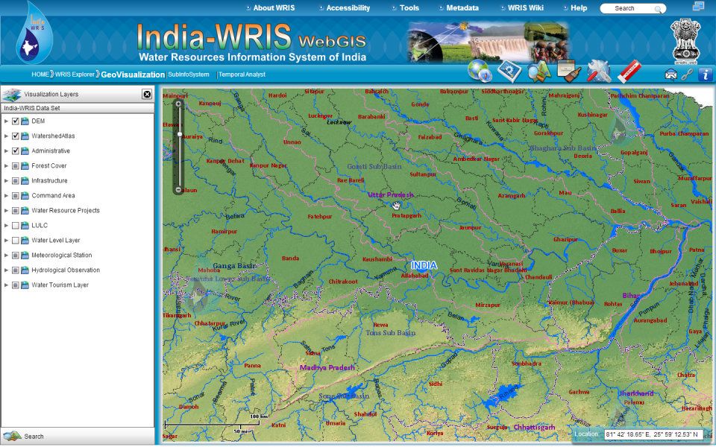
INDIA-WRIS : Geo-visualization

Slide 19


Tools and Functionalities
Navigation Tools
Zoom Out: Is zooms-out the map to come out of the detailing..
Pan: It allows user to Pan around the whole map
Full Extent: It allows viewing the map at the full extent..
Previous Extent: It allows going to previous extent when the map extent is changed.
Next Extent: It allows returning from the previous extent.
Map Overview: Provides location of current view in context with larger map area.
Go To: Zoom to an area based on specified latitude and longitude
Select Area Zoom/Rubber Zoom: Smooth Zooming into a selected area
Display Tools
Swipe: It swipe the selected layer in the map to reveal underlying layers.
Spotlight: It removes overlaid layer from the selected portion for better visualization
Magnifier: To view the zoom in layer details of selected portion only
Get Feature Info: On selecting a particular feature it displays summary info
Identify: Identify the details of all the visible layers including the elevation details of the point

Slide 20











Tools and Functionalities
Personalization Tools
Print: To print the current viewing area in landscape or portrait mode.
Save as Image
Bookmark: Allows book marking a specific location on the map for future reference.
Pin Mark: User can pin mark his location of interest and type his comment on same
Sharing Tools
Share a Link: Share the current view of map with another user through mail.
iFrame: Sharing frame of India-WRIS in other applications.
Links on twitter/Facebook/Google+
Advanced Tools
Surface Profile: Generate the surface terrain height graph of selected points on map.
Network Analysis/Route Tool: It specifies the defined route of road, rail and river network.
GeoCalculator: Tools to calculate parameters based on location and user input.
Linked View: Can View multiple view of different information in a single window.
Search & Query Tools
Query Builder: create user defined queries
Draw: Allows to draw a shape/line/point on map
Search by Proximity

Slide 21
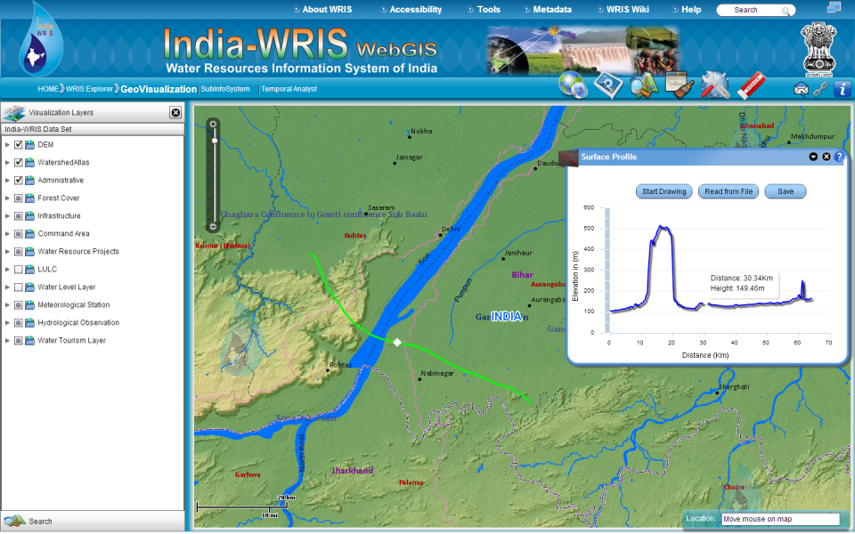
Geo-visualization : Surface profile Tool

Slide 22
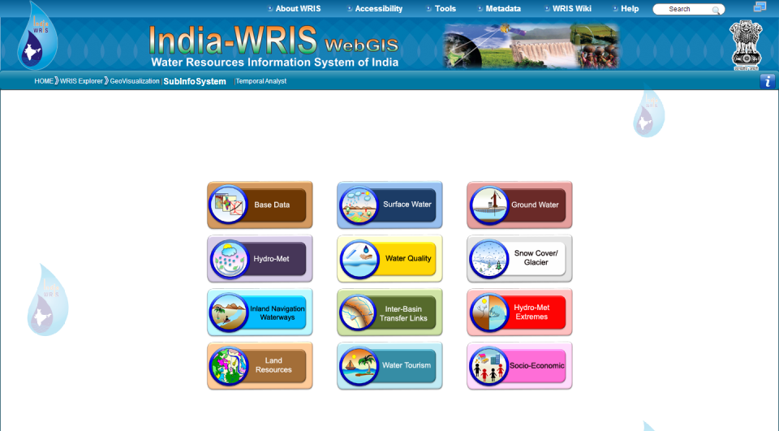
Sub-information system

Slide 23
Main Information System – 12 Sub System – 35,
Layers - 108 and Attributes - > 4000
1. Base Data Info Systems
7. Inland Navigation Waterways Info Systems
  Administrative
  Region
  Infrastructure
  Terrain
Inland Navigation Waterways
2. Surface Water Info Systems
8. Inter - Basin Transfer Links Info Systems
Water Resource
Division
Basin
Watershed
River
Surface Water Body
Water Resources Projects
Command Area
Minor Irrigation
Canal
Inter - Basin Transfer Links
9. Hydro - Met Extremes
3. Ground Water Info Systems
Flood
Drought
Extremes Events
Aquifer / Litholog
Ground Water Level
Ground Water Potential (RGDWM)
10. Land Resources Info Systems
4. Hydro - Met Info Systems
  Land Use / Land Cover
  Land Degradation
  Wasteland
  Soil
Meteorological
Climate
Hydro - Observation
Flood Forecasting
5. Water Quality Info Systems
11. Water Tourism Info Systems
Surface Water Quality
Ground Water Quality
Water Tourism
6. Snow Cover / Glacier Info Systems
12. Socio Economic Info Systems
Snow Cover / Glacier
Rural
Urban

Slide 24
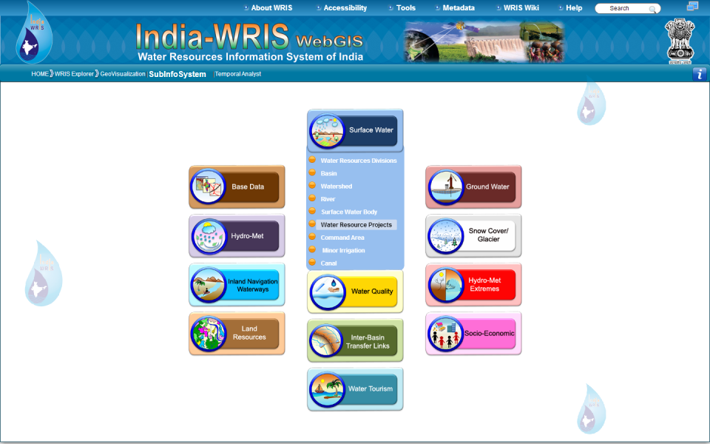
Sub-information system

Slide 25
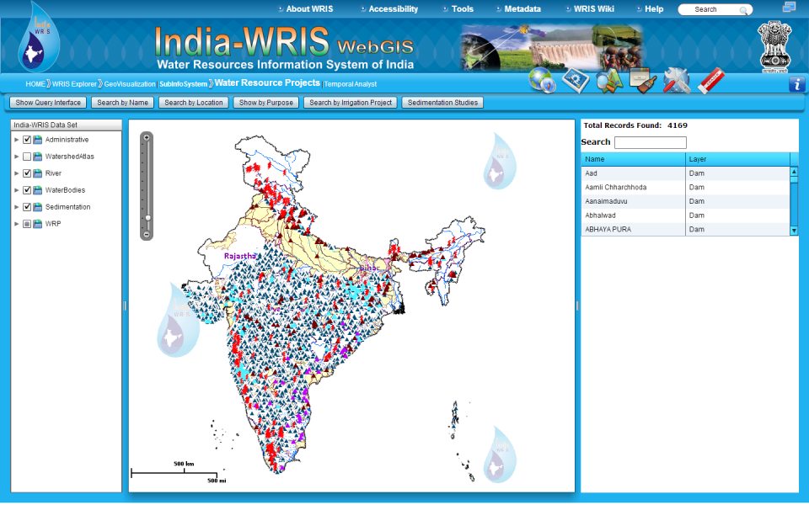
Water resources Project Sub-info
Total major & Medium Irrigation Projects - 1748
Total Large Dams- 4575
Number of Barrages - 540
Number of Lifts - 352
Canal Network –3.2 lakh km
Hydro Power Stations – 293
Waterbodies- 8.0 lakh

Slide 26
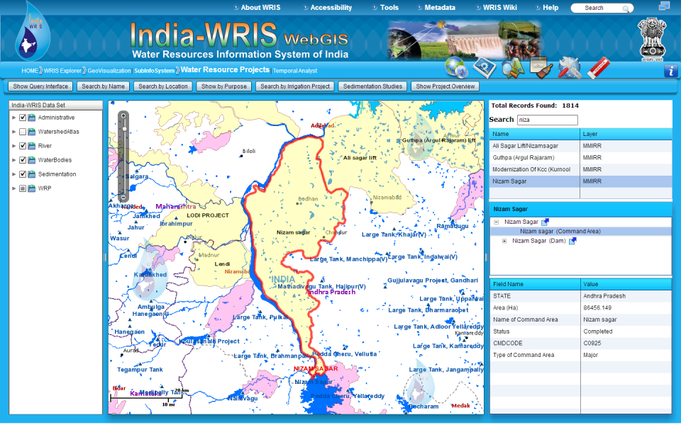
Water resources Project Sub-info

Slide 27
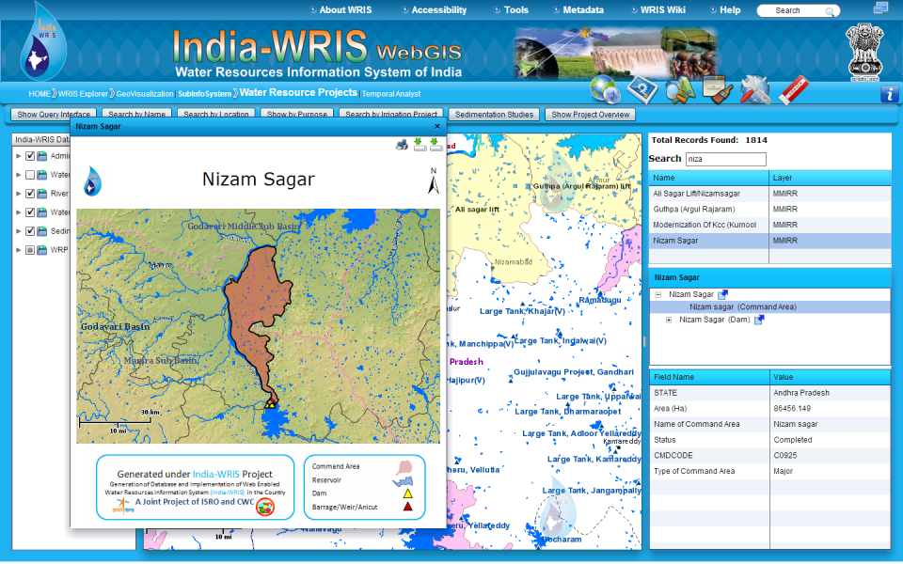
Water resources Project Sub-info

Slide 28
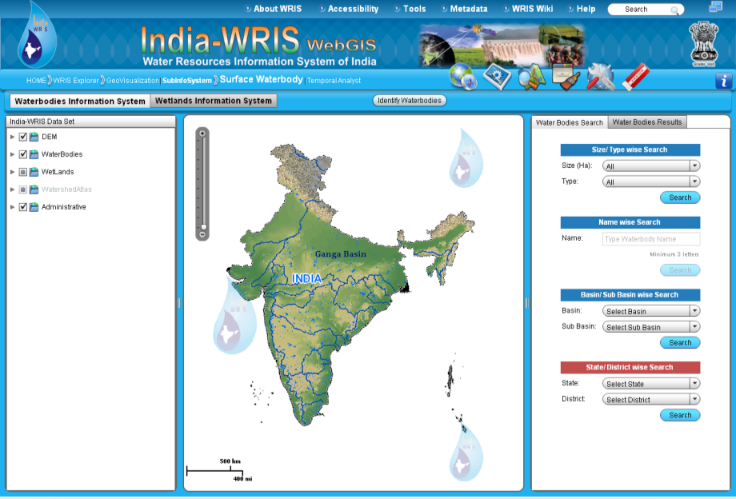
Surface Water-Bodies
Total around 8.0 lakh water bodies

Slide 29
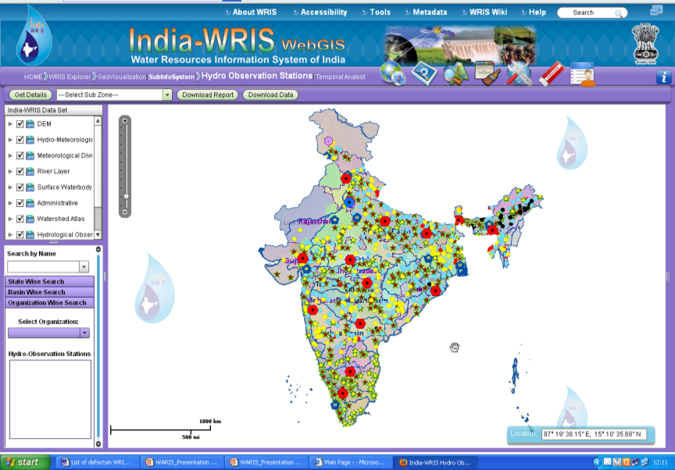
CWC H.O. Network
Total – 878 Sites
Time Series Data
from 10 to 40 years for Un-classified Region

Slide 30
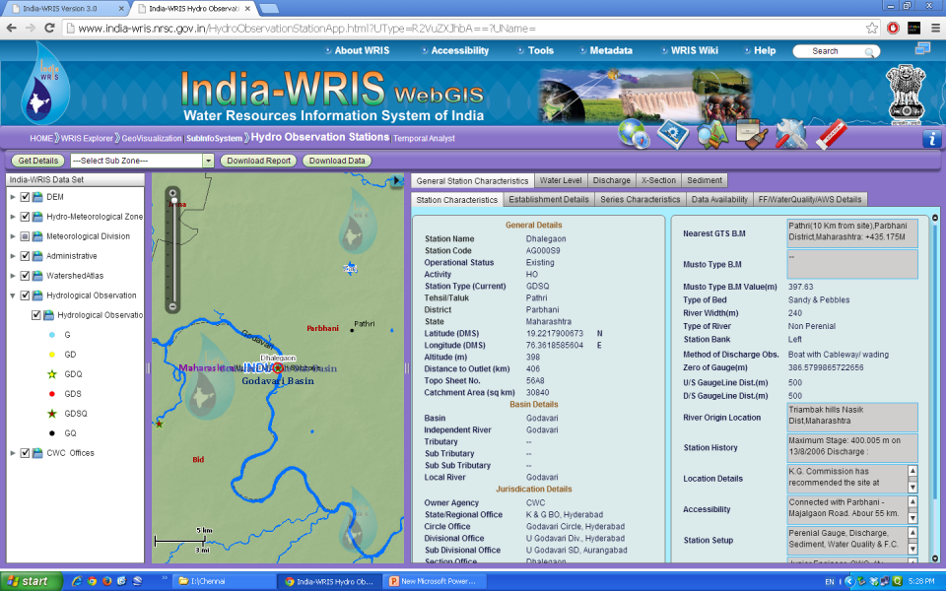
Data of CWC HO sites

Slide 31
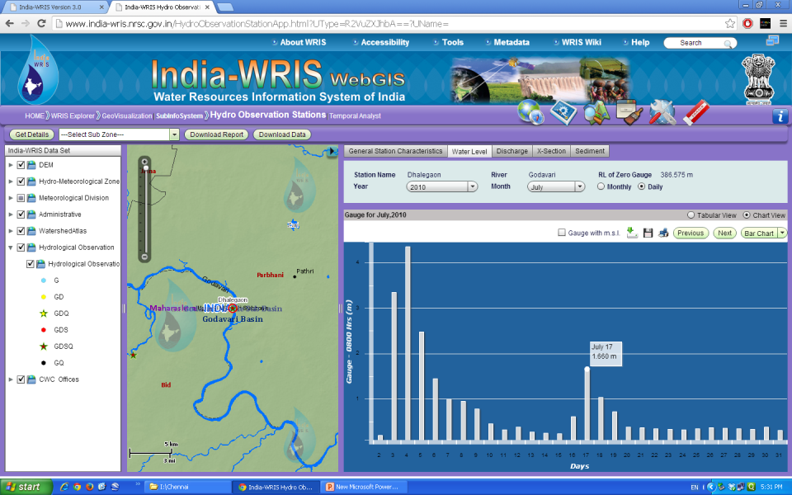
Data of CWC HO sites

Slide 32
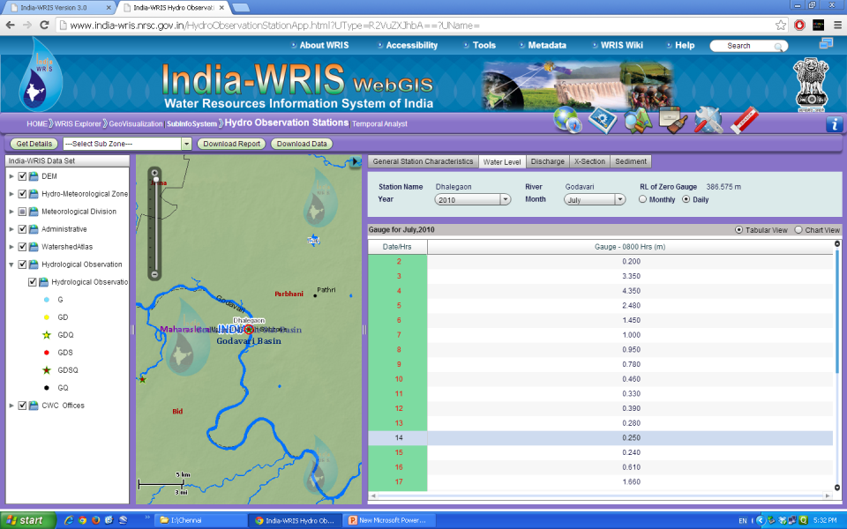
Data of CWC HO sites

Slide 33
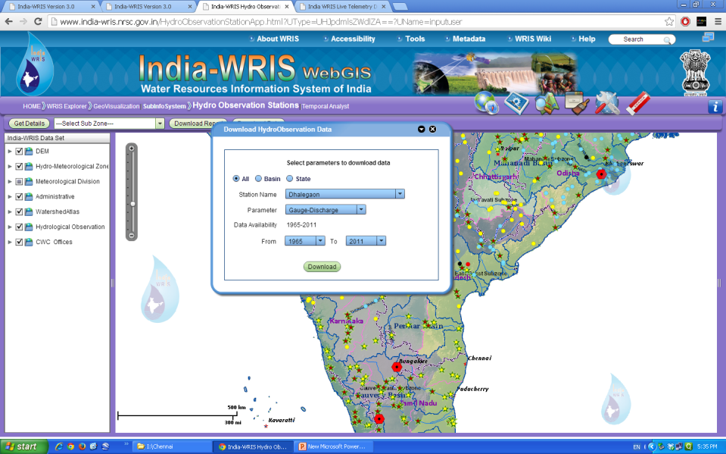
Data Download of CWC HO sites

Slide 34
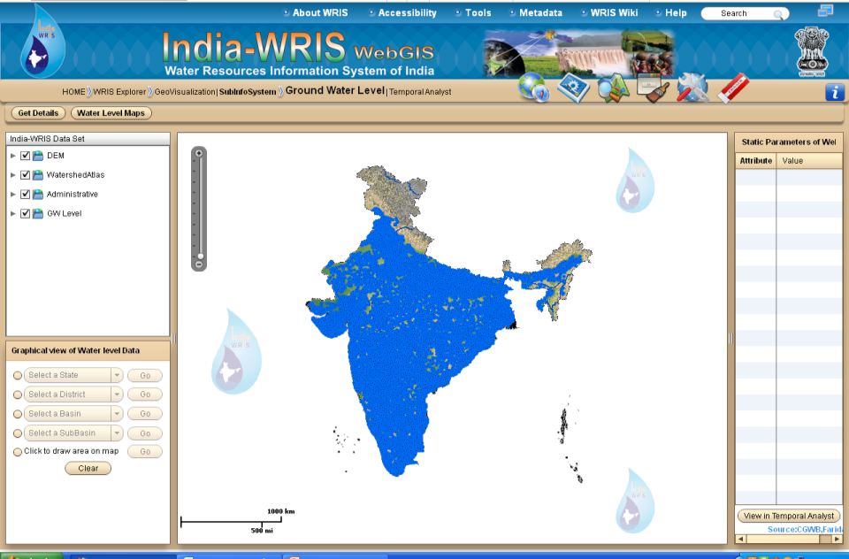
CGWB Ground Water Well Network
Total 17,000 well located
Time series data from 1995 to 2010

Slide 35
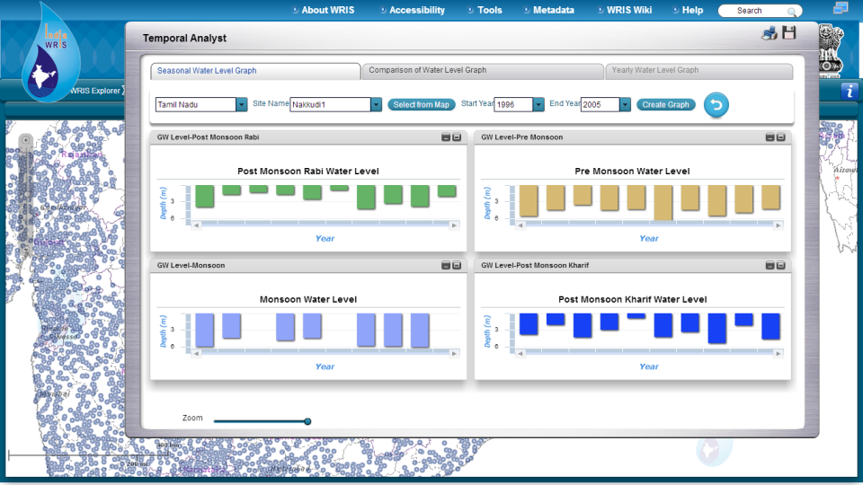
Ground Water Levels in temporal Analyst

Slide 36
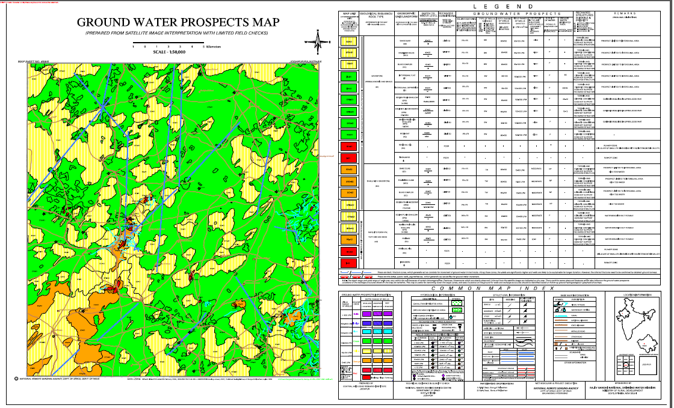
Rajiv Gandhi Drinking Water Mission

Slide 37
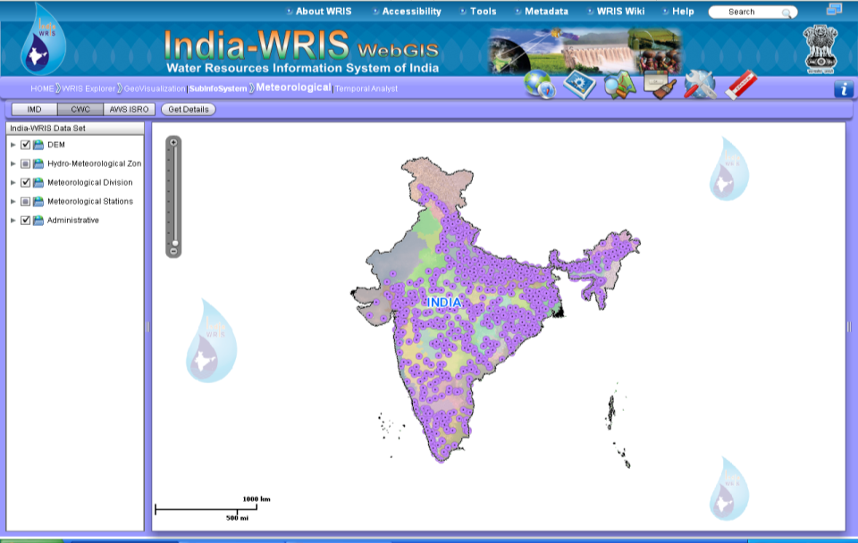
CWC Meteorological Network
Total Stations - 851

Slide 38
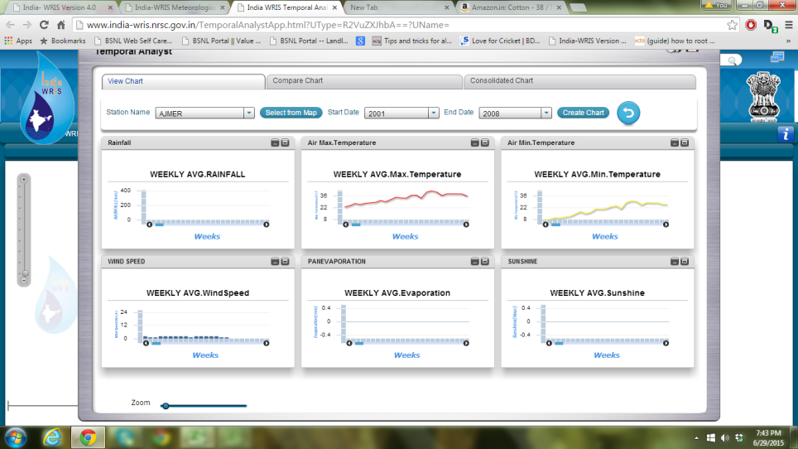
Temporal data of IMD

Slide 39
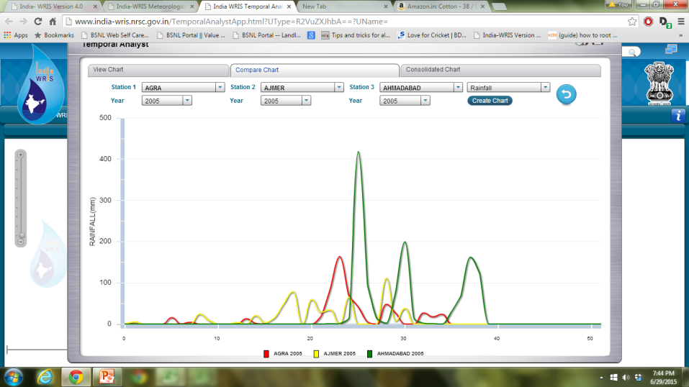
Temporal data of IMD

Slide 40
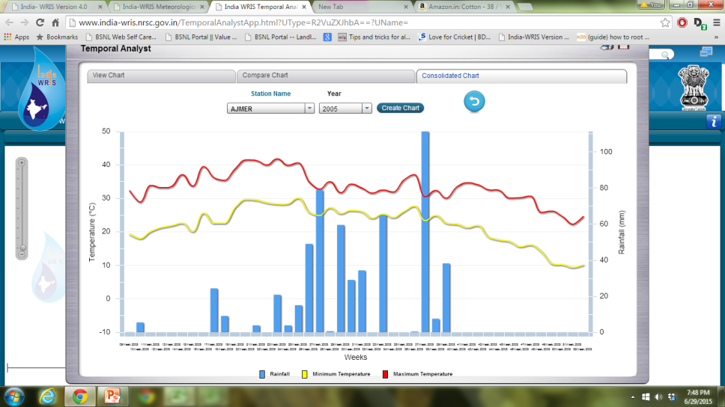
Temporal data of IMD

Slide 41
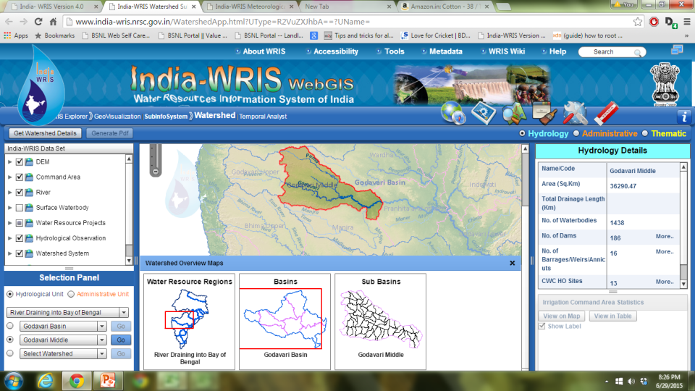
Watershed Module

Slide 42
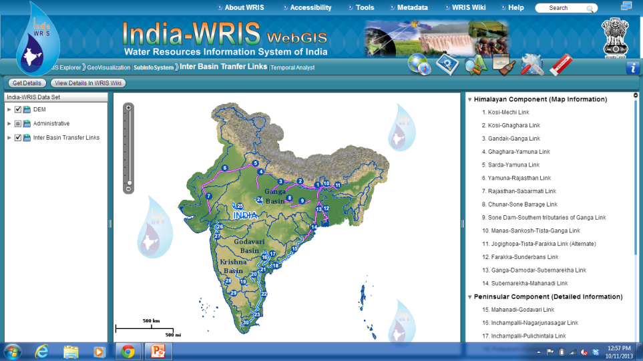
Inter Basin Transfer Links

Slide 43
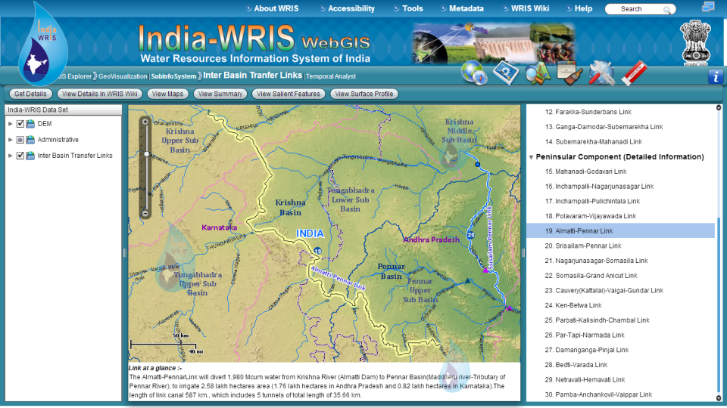
Inter Basin Transfer Links

Slide 44
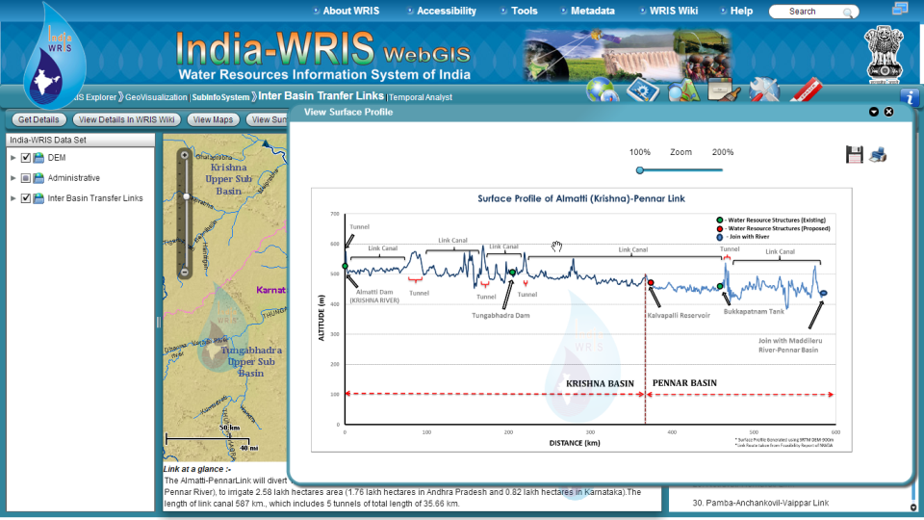
Inter Basin Transfer Links

Slide 45
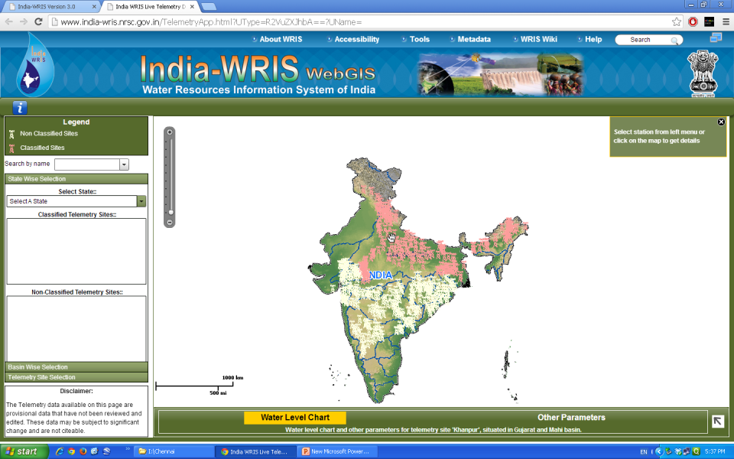
Live Telemetry Data of CWC

Slide 46
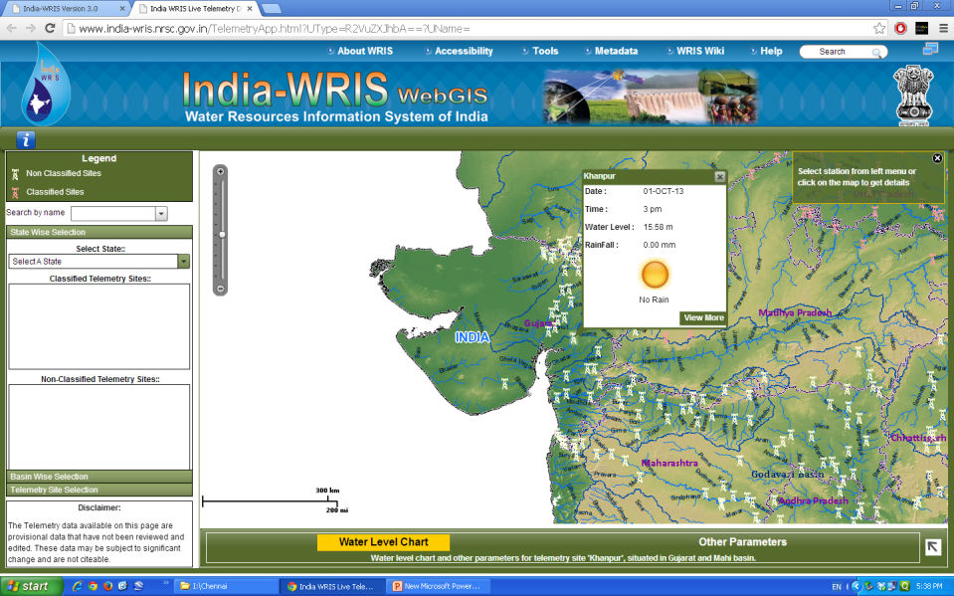
Live Telemetry Data- Khanpur

Slide 47
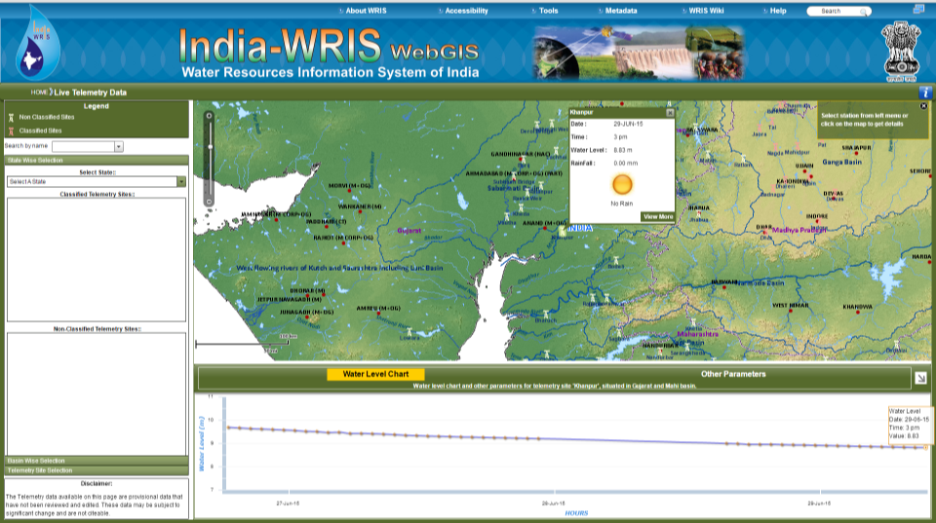
Khanpur site – 29/06/15, 05:30 PM

Slide 48
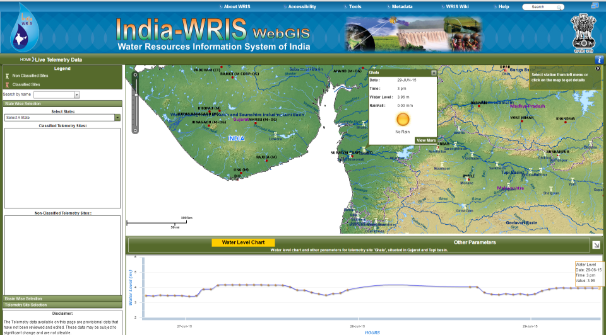
Ghala site – 29/06/15, 05:30 PM

Slide 49
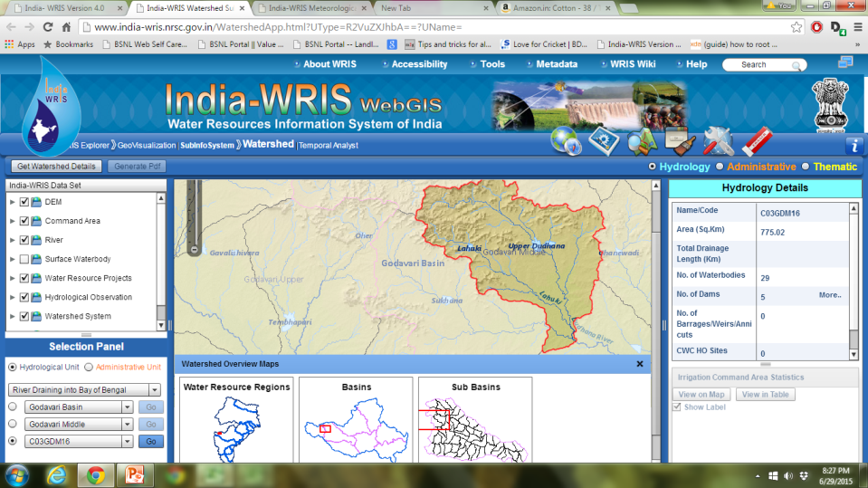
Watershed Module

Slide 50
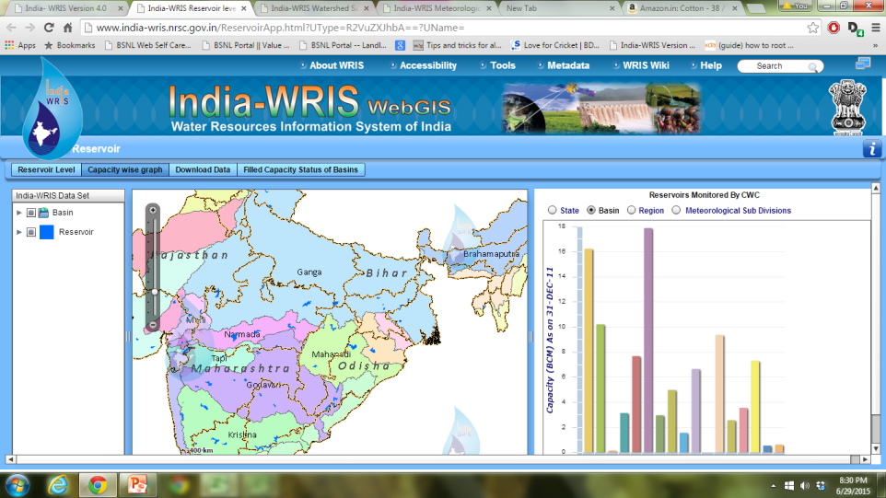
Reservoir Module
CWC Monitors Storages for 85 Reservoirs (Covers 60 % storage capacity)
Time Series data (20 years)

Slide 51

Reservoir Module

Slide 52

Automatic Map Generation

Slide 53

Automatic Map Generation

Slide 54

Automatic Map Generation

Slide 55

Automatic Map Generation

Slide 56

Automatic Report Generation

Slide 57

Automatic Report Generation

Slide 58


2D-3D Linked View

Slide 59

WRIS-WIKI

Slide 60


Linked View with Bhuvan Portal

Slide 61
User Statistics: Version 2.0,3.0 & 4.0
(22 March, 2012 to December, 2014)
User Track Module : http://www.india-wris.nrsc.gov.in/iptrackv4
Country | Visits
United States | 20356
France | 3990
United Kingdom | 3760
China | 3023
Germany | 2021
Canada | 1718
Australia | 1690
Netherlands | 1665
Singapore | 1620
United Arab Emirates | 1503
Pakistan | 1384
Japan | 1262
Hong Kong | 1094
Others | 14102
Total Visits: 653840
Visitors from India: 582326
Visitors from other countries (153 Countries): 71514
Total Downloads: 20192
Download Statistics

Slide 62



NEW Digital Watershed atlas
Sl. No. | Hydrological Levels | Digits | Range
1 | Region | 1 | A-E
2 | Basin | 02 | 1 – 25
3 | Sub Basin | 03 | XYZ
4 | Watersheds | 02 | 1 – 99
5 | Sub Watersheds | 03 | L 1 - 99 M 1 - 99 U 1 - 99
6 | Micro Watersheds | 02 | 1 - 99
Mahanadi Basin
C 08 xyz 99 L99 99
Notes:
62

Slide 63

WATER RESOURCES
- DIVISIONS
Water Resources Region

Slide 64


Slide 65



Slide 66
Major Achievement of the Project
Major Part of Water and Water related data (Spatial and Non-Spatial) is available at one Platform including Irrigation Infrastructure
Help Senior Officers both at Centre and State in Day to Day Decision Making process, including funding of Irrigation Projects under AIBP, CADWM Programme & Conflict Resolution
Helpful in Appraisal Process of Irrigation/HE Projects
For Data Dissemination to Researchers
It will bring more transparency as well create awareness about countries Water Resources Scenario amongst the different stake-holders

Slide 67

Future Work & Challenges
To evolve mechanism for updation of data at regular interval (Monthly basis, quarterly basis, yearly basis)
Integration of Ground Water Information system
Integration of Water Utilisation data, agriculture data by State Governments as these databases will be useful for reassessment of water resources availability study, Basin Planning etc
Bringing IMD, CPCB on WRIS platform. Only then complete data on water will be available
Development of Flood inundation modeling by CWC with inputs from IMD, Generation of Close contours (0.5 metre interval) & CWC Telemetry network
Mapping of Flood protection works
Mapping of CADA Works

Slide 68
Continued
Integration of Morphological studies done by CWC with IIT
Integration of PMP Atlas being developed by CWC
Integration of Hydrological Tools being Developed by CWC
Expansion of CWC H.O. network, Telemetry Network During XII Plan
Creation/collection of Block Boundaries & Revenue village boundary for integration of Minor Irrigation census data
Crowd sourcing (Involving of Public) for collecting data especially in respect of smaller water bodies, water polluting locations etc.

Slide 69
National Water Informatics Center

Slide 70
Conceptual Framework for Inter-Institutional Linkages – NWRIC
Regional Node
(State Water Data Centre – SDWC)
CWC Observational Network
( Real-time River G, G&D , Reservoir Level Data)
Census & Statistics
Hydrology Data Base
(WISDOM, HDA,SWDES Hydrology Project II)
ISRO-Bhuvan
Ministry
of
Agriculture
National Water Resources Information Centre
Environmental Data
(CPCB)
Water Quality data
India Meteorological Department
CWC Monitoring units
CWC Dte at headquarters
India-WRIS
GWIS (CGWB)
(GW Levels, quality)
Ministry
of
Rural Development
Survey
of
India
data.gov.in

Slide 71




Thank you
http://www.india-wris.nrsc.gov.in

